Slide 1


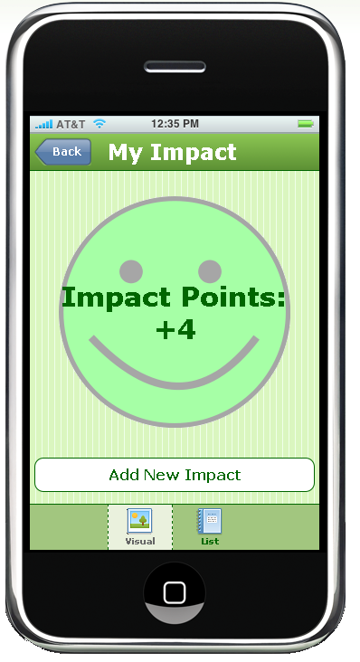
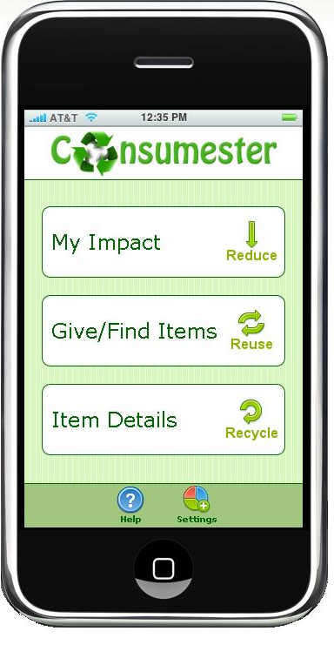
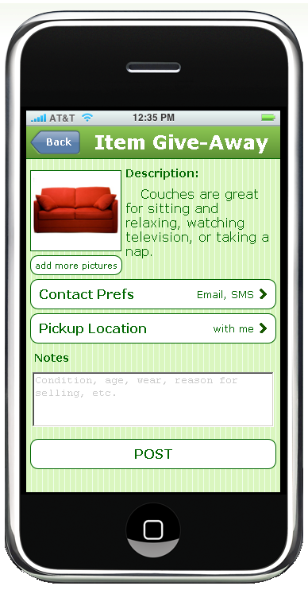
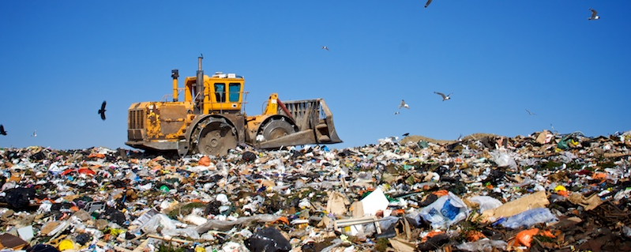
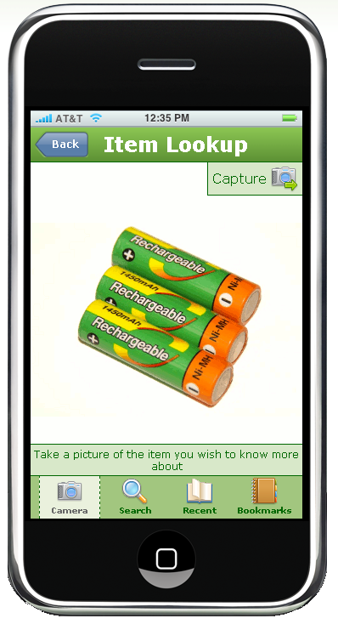

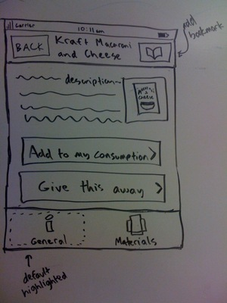
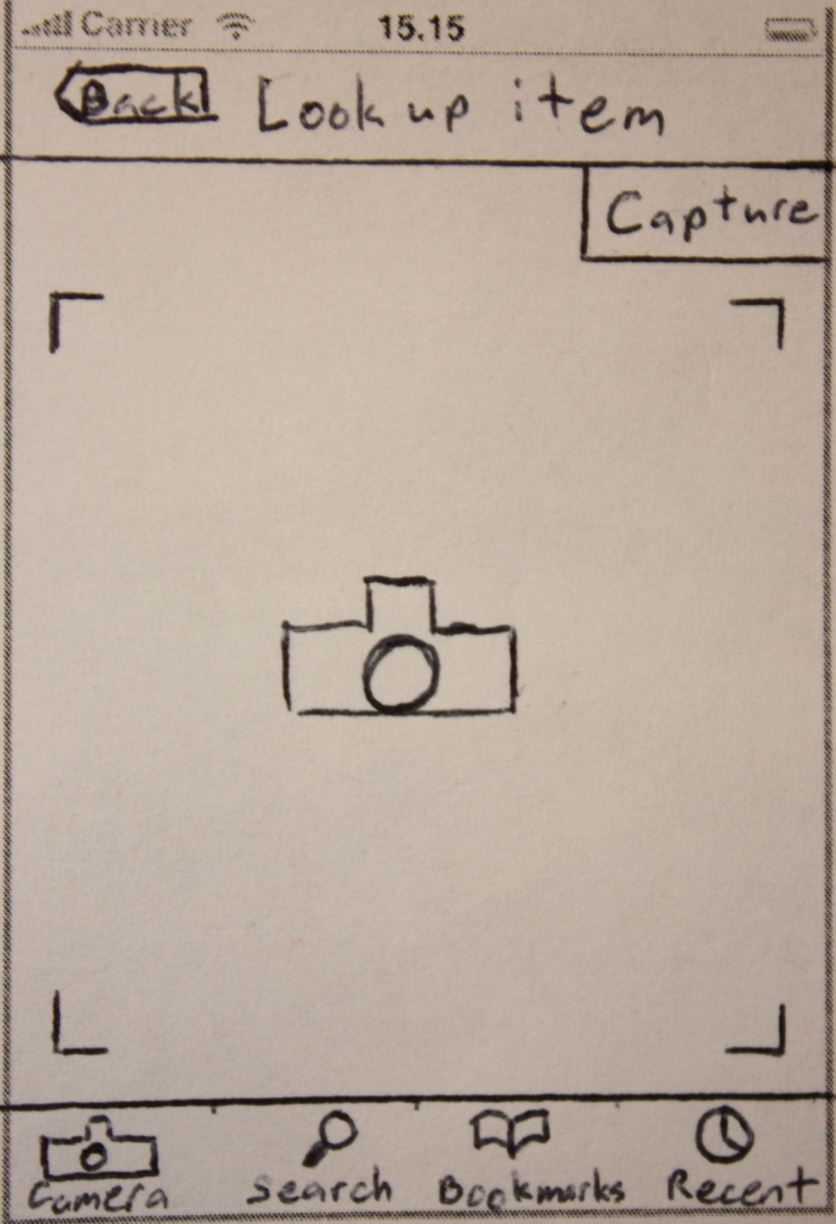
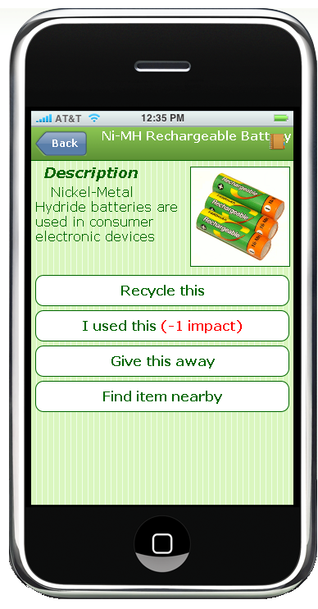


HELPING THE ENVIRONMENT ONE PERSON AT A TIME
Problem:
Why don’t people recycle everything they can? In 2008, 120 million tons of recyclable materials were thrown away
Incentive
Track your Impact Points as you play along with Consumester’s features
Mobile
Give away and view items based on your current location
Convenience
Take a picture of an object and get instant recycling information
Solution:
A mobile recycling application that provides convenient features and incentives to encourage better habits
Design
Iteration:
Contextual Inquiry
Usability Testing
narrowed design focus
discovered high-level &
low-level issues
Sketches
Paper Prototype
Interactive Prototype
Waste Statistics:
Environmental Protection Agency
Michael Abel | Patrick Healy | Cullen Walsh
http://www.cs.washington.edu/education/courses/cse440/09au/projects/consumester/
CSE 440
Autumn 2009

